Slide 1
STEMM Student Challenge 2019

Slide 2
QUESTIONS
ROUND 1 Senior Section Years 11-13

Slide 3
Q1
What is the common name for Nitrous Oxide?

Slide 4
Q2
Betelgeuse and Rigel are the two giant stars in which constellation?

Slide 5
Q3
Who carried out experiments on gravity from the leaning tower of Pisa?

Slide 6
Q4
Cubic zirconia is a synthesized material often used in place of what precious stone?

Slide 7
Q5
What is the name for the study of cells?

Slide 8
Q6
What do the letters CPU stand for when referring to the "brains" of a computer?

Slide 9
Q7
What famous scientist had a price on his head by the Nazis, was offered the Presidency of Israel, and didn't wear socks?

Slide 10
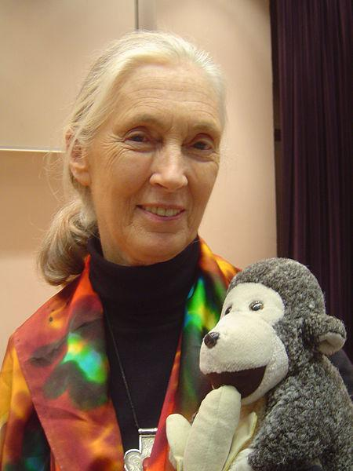
Q8
Who is this internationally famous scientist?

Slide 11
Q9
What body opening are the labial and buccal glands in?

Slide 12
Q10
What chemical element has the shortest name?

Slide 13
ANSWERS
ROUND 1 Senior Section Years 11-13

Slide 14
Q1: WHAT IS THE COMMON NAME FOR NITROUS OXIDE?
ANSWER: LAUGHING GAS

Slide 15
Q2: BETELGEUSE AND RIGEL ARE THE TWO GIANT STARS IN WHICH CONSTELLATION?
ANSWER: ORION

Slide 16
Q3: WHO CARRIED OUT EXPERIMENTS ON GRAVITY FROM THE LEANING TOWER OF PISA?
ANSWER: GALILEO

Slide 17
Q4: CUBIC ZIRCONIA IS A SYNTHESIZED MATERIAL OFTEN USED IN PLACE OF WHAT PRECIOUS STONE?
ANSWER: DIAMOND

Slide 18
Q5: WHAT IS THE NAME FOR THE STUDY OF CELLS?
ANSWER: CYTOLOGY

Slide 19
Q6: WHAT DO THE LETTERS CPU STAND FOR WHEN REFERRING TO THE "BRAINS" OF A COMPUTER?
ANSWER: CENTRAL PROCESSING UNIT

Slide 20
Q7: WHAT FAMOUS SCIENTIST HAD A PRICE ON HIS HEAD BY THE NAZIS, WAS OFFERED THE PRESIDENCY OF ISRAEL, AND DIDN'T WEAR SOCKS?
ANSWER: ALBERT EINSTEIN

Slide 21
Q8: WHO IS THIS INTERNATIONALLY FAMOUS SCIENTIST?
ANSWER:
JANE GOODALL

Slide 22
Q9: WHAT BODY OPENING ARE THE LABIAL AND BUCCAL GLANDS IN?
ANSWER: THE MOUTH

Slide 23
Q10: WHAT CHEMICAL ELEMENT HAS THE SHORTEST NAME?
ANSWER: TIN

Slide 24
QUESTIONS
ROUND 2 Senior Section Years 11-13

Slide 25
Q11
True or false? Plasma is a state of matter?

Slide 26
Q12
When referring to cables used to transmit audio/video, what does HDMI stand for?

Slide 27
Q13
Late 2018 saw emergency vaccinations in Northland following the outbreak of a deadly strain of what disease?

Slide 28
Q14
What is the only letter not in the periodic table?

Slide 29
Q15
On a radio, what does FM stand for?

Slide 30
Q16
Which two elements on the periodic table are liquids at room temperature?

Slide 31
Q17
In the 2001 movie, A Beautiful Mind, Russell Crowe plays which Nobel Prize winning mathematician?

Slide 32
Q18
What sort of vehicle was the uplifting invention of Sir Christopher Cockerell?

Slide 33
Q19
Which gland in the human body regulates metabolism?

Slide 34
Q20
Introduced in 1773, which breed of sheep was the first to arrive in NZ?

Slide 35
ANSWERS
ROUND 2 Senior Section Years 11-13

Slide 36
Q11: TRUE OR FALSE? PLASMA IS A STATE OF MATTER?
ANSWER: TRUE

Slide 37
Q12: WHEN REFERRING TO CABLES USED TO TRANSMIT AUDIO/VIDEO, WHAT DOES HDMI STAND FOR?
ANSWER: HIGH-DEFINITION MULTIMEDIA INTERFACE

Slide 38
Q13: LATE 2018 SAW EMERGENCY VACCINATIONS IN NORTHLAND FOLLOWING THE OUTBREAK OF A DEADLY STRAIN OF WHAT DISEASE?
ANSWER: MENINGOCOCCAL DISEASE (MENINGITIS)

Slide 39
Q14: WHAT IS THE ONLY LETTER NOT IN THE PERIODIC TABLE?
ANSWER: THE LETTER J

Slide 40
Q15: ON A RADIO, WHAT DOES FM STAND FOR?
ANSWER: FREQUENCY MODULATION

Slide 41
Q16: WHICH TWO ELEMENTS ON THE PERIODIC TABLE ARE LIQUIDS AT ROOM TEMPERATURE?
ANSWER: MERCURY AND BROMINE

Slide 42
Q17: IN THE 2001 MOVIE, A BEAUTIFUL MIND, RUSSELL CROWE PLAYS WHICH NOBEL PRIZE WINNING MATHEMATICIAN?
ANSWER: JOHN NASH

Slide 43
Q18: WHAT SORT OF VEHICLE WAS THE UPLIFTING INVENTION OF SIR CHRISTOPHER COCKERELL?
ANSWER: THE HOVERCRAFT

Slide 44
Q19: WHICH GLAND IN THE HUMAN BODY REGULATES METABOLISM?
ANSWER: THYROID

Slide 45
Q20: INTRODUCED IN 1773, WHICH BREED OF SHEEP WAS THE FIRST TO ARRIVE IN NZ?
ANSWER: MERINO

Slide 46
PRACTICAL TASK
This year we have 3 practical challenges:
Year of the Periodic Table Challenge
Building Challenge
Coding Challenge

Slide 47
Year of the Periodic Table Challenge (3 marks)
What element is found in and “closely associated with” the 6 everyday items you have been given.

Slide 48
Building Challenge (4 marks)
Using only the equipment provided, build the tallest structure, as measured from the table surface to the top of the marshmallow. You have 15 minutes and should read the set of rules carefully
Over 5cm = 1 mark Over 20cm = 2 marks
Over 35cm = 2 marks Over 50cm = 4 marks

Slide 49
Coding Challenge (3 marks)
A Racetrack will be shown on screen and you must programme your team Bot to complete the circuit, from behind the Start line to over the Finish line. Instructions have been provided to each team
Reach Tyre Arch = 1 mark
Reach Man with Flag = 2 marks
Cross the finish line = 3 Marks

Slide 50
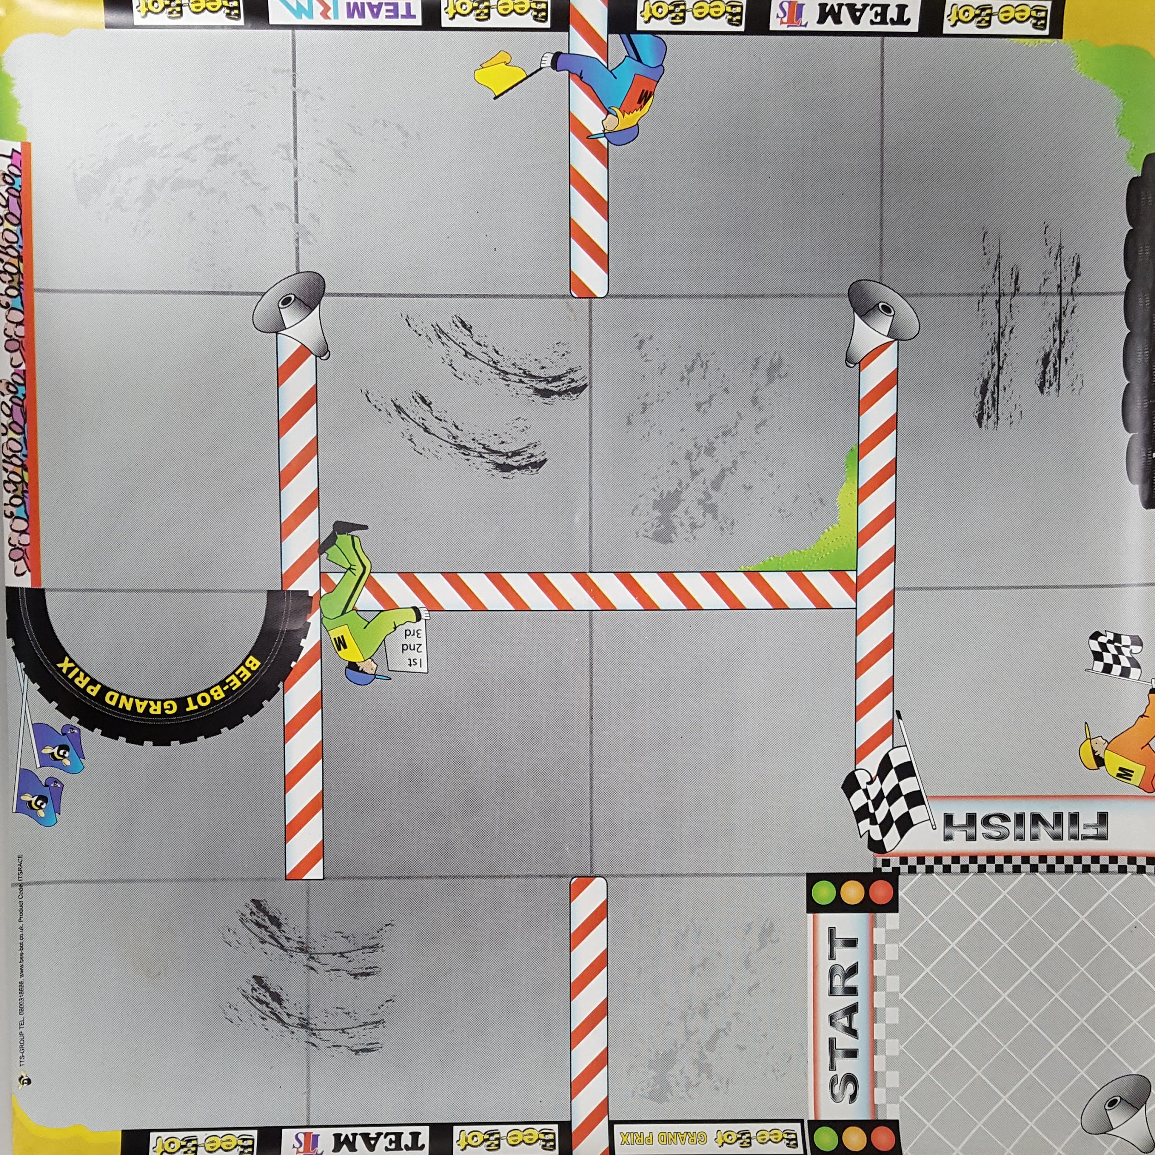

Slide 51
ELEMENT
CHALLENGE
ANSWERS

Slide 52
Year of the Periodic Table Challenge
A: Polonium D: Silicon or Iron
B: Phosphorus E: Calcium
C: Carbon F: Boron

Slide 53
QUESTIONS
ROUND 4 Senior Section Years 11-13

Slide 54
Q21
What is the only snake in the world that builds a nest for its eggs?

Slide 55
Q22
What layer of the atmosphere lies between the troposphere and mesosphere?

Slide 56
Q23
Which German physicist was the first to develop quantum theory?

Slide 57
Q24
The atmospheric temperature at which water vapor begins to condense and form dew, is called what?

Slide 58
Q25
What is the most common blood type in humans?

Slide 59
Q26
What family of elements is in the left-most column of the Periodic Table?

Slide 60
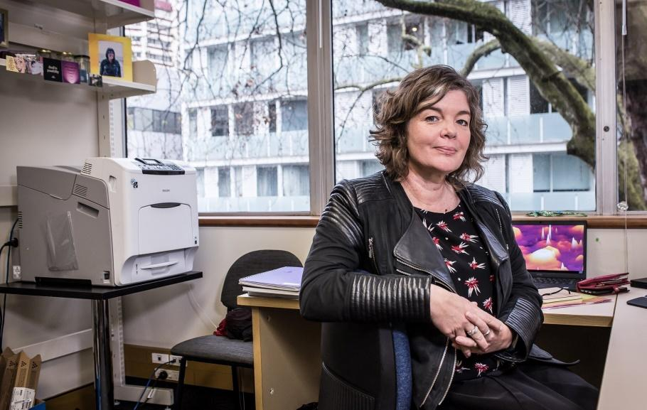
Q27
This is Professor Juliet Gerard - what prestigious Science position does she hold in NZ?

Slide 61
Q28
Wine is classified into 3 major categories: Still, Sparkling and which other?

Slide 62
Q29
The name of which narcotic drug is named after Morpheus the Greek god of dreams?

Slide 63
Q30
What common drink was first called Esteemed brain tonic and intellectual beverage?

Slide 64
ANSWERS
ROUND 4 Senior Section Years 11-13

Slide 65
Q21: WHAT IS THE ONLY SNAKE IN THE WORLD THAT BUILDS A NEST FOR ITS EGGS?
ANSWER: KING COBRA

Slide 66
Q22: WHAT LAYER OF THE ATMOSPHERE LIES BETWEEN THE TROPOSPHERE AND MESOSPHERE?
ANSWER: STRATOSPHERE

Slide 67
Q23: WHICH GERMAN PHYSICIST WAS THE FIRST TO DEVELOP QUANTUM THEORY?
ANSWER: MAX PLANCK

Slide 68
Q24: THE ATMOSPHERIC TEMPERATURE AT WHICH WATER VAPOR BEGINS TO CONDENSE AND FORM DEW, IS CALLED WHAT?
ANSWER: DEW POINT

Slide 69
Q25: WHAT IS THE MOST COMMON BLOOD TYPE IN HUMANS?
ANSWER: O+

Slide 70
Q26: WHAT FAMILY OF ELEMENTS IS IN THE LEFT-MOST COLUMN OF THE PERIODIC TABLE?
ANSWER: ALKALI METALS (NOT ALKALINE)

Slide 71
Q27: THIS IS PROFESSOR JULIET GERARD - WHAT PRESTIGIOUS SCIENCE POSITION DOES SHE HOLD IN NZ?
ANSWER: PRIME MINISTER'S CHIEF OF SCIENCE ADVISOR

Slide 72
Q28: WINE IS CLASSIFIED INTO 3 MAJOR CATEGORIES: STILL, SPARKLING AND WHICH OTHER?
ANSWER: FORTIFIED

Slide 73
Q29: THE NAME OF WHICH NARCOTIC DRUG IS NAMED AFTER MORPHEUS THE GREEK GOD OF DREAMS?
ANSWER: MORPHINE

Slide 74
Q30: WHAT COMMON DRINK WAS FIRST CALLED ESTEEMED BRAIN TONIC AND INTELLECTUAL BEVERAGE?
ANSWER: COCA COLA

Slide 75
QUESTIONS
ROUND 5 Senior Section Years 11-13

Slide 76
Q31
Which migratory bird is known in Māori as Kuaka?

Slide 77
Q32
What is the common name for dilute acetic acid?

Slide 78
Q33
What does the acronym USB stand for when referring to a computer port?

Slide 79
Q34
What is the common name for 'nacre', the irridescent internal layer of certain mollusk shells?

Slide 80
Q35
What famous scientist/inventor is reported to have run naked from the bath shouting Eureka?

Slide 81
Q36
In late 2018, a Government Report denounced the need for widespread testing of houses for what substance?

Slide 82
Q37
What element is used in luminous watch dials?

Slide 83
Q38
Rickets is a disease caused by a deficiency of which vitamin?

Slide 84
Q39
What Physics Law gives us the relationship between current and voltage?

Slide 85
Q40
In February 2019 car shipments were turned away at the NZ border when they were found to be infested by what bug?

Slide 86
ANSWERS
ROUND 5 Senior Section Years 11-13

Slide 87
Q31: WHICH MIGRATORY BIRD IS KNOWN IN MĀORI AS KUAKA?
ANSWER: GODWIT

Slide 88
Q32: WHAT IS THE COMMON NAME FOR DILUTE ACETIC ACID?
ANSWER: VINEGAR

Slide 89
Q33: WHAT DOES THE ACRONYM USB STAND FOR WHEN REFERRING TO A COMPUTER PORT?
ANSWER: UNIVERSAL SERIAL BUS

Slide 90
Q34: WHAT IS THE COMMON NAME FOR 'NACRE', THE IRRIDESCENT INTERNAL LAYER OF CERTAIN MOLLUSK SHELLS?
ANSWER: MOTHER-OF-PEARL

Slide 91
Q35: WHAT FAMOUS SCIENTIST/INVENTOR IS REPORTED TO HAVE RUN NAKED FROM THE BATH SHOUTING EUREKA?
ANSWER: ARCHIMEDES

Slide 92
Q36: IN LATE 2018, A GOVERNMENT REPORT DENOUNCED THE NEED FOR WIDESPREAD TESTING OF HOUSES FOR WHAT SUBSTANCE?
ANSWER: METHAMPHETAMINE

Slide 93
Q37: WHAT ELEMENT IS USED IN LUMINOUS WATCH DIALS?
ANSWER: RADIUM

Slide 94
Q38: RICKETS IS A DISEASE CAUSED BY A DEFICIENCY OF WHICH VITAMIN?
ANSWER: VITAMIN D

Slide 95
Q39: WHAT PHYSICS LAW GIVES US THE RELATIONSHIP BETWEEN CURRENT AND VOLTAGE?
ANSWER: OHM'S LAW

Slide 96
Q40: IN FEBRUARY 2019 CAR SHIPMENTS WERE TURNED AWAY AT THE NZ BORDER WHEN THEY WERE FOUND TO BE INFESTED BY WHAT BUG?
ANSWER: BROWN MARMORATED STINK BUG

Slide 97
Well done to all teams participating in STEMM Student Challenge 2019
huttscience.co.nz

Slide 98
TIE BREAKER

Slide 99
Question
What's the oldest man-made alloy?

Slide 100
Answer
Bronze

Slide 101
Question
Of the original six space shuttles, which one never flew a mission in space?

Slide 102
Answer
Enterprise

Slide 103
Question
What element produces the orange colour in fireworks?

Slide 104
Answer
Calcium

Slide 105
Question
In terms of engineering software, what does CAD stand for?

Slide 106
Answer
Computer Aided Design

Slide 107
Question
What is the fourth most abundant element in the universe in terms of mass?

Slide 108
Answer
Carbon

Slide 109
Question
What is the technical term for thickness of a liquid?

Slide 110
Answer
Viscosity

Slide 111
Question
In science, how long is an eon?

Slide 112
Answer
One billion years

Slide 113
Question
What bacterial infection is currently resulting in the culling of large numbers of dairy cows in NZ?

Slide 114
Answer
Mycoplasma bovis

Slide 115
Question
What inorganic molecule is produced by lightning?

Slide 116
Answer
Ozone

Slide 117
Question
In our solar system, which planet has the shortest day?

Slide 118
Answer
Jupiter

