Slide 1
STEMM Student Challenge 2019

Slide 2
QUESTIONS
ROUND 1 Primary Section Years 5-6

Slide 3
Q1
On which popular website do users send tweets?

Slide 4
Q2
What industry are Henry Ford and Karl Benz associated with?

Slide 5
Q3
Green, leatherback and loggerhead are types of: (a) dog (b) crocodile (c) turtle?

Slide 6
Q4
Triceps and biceps are types of what?

Slide 7
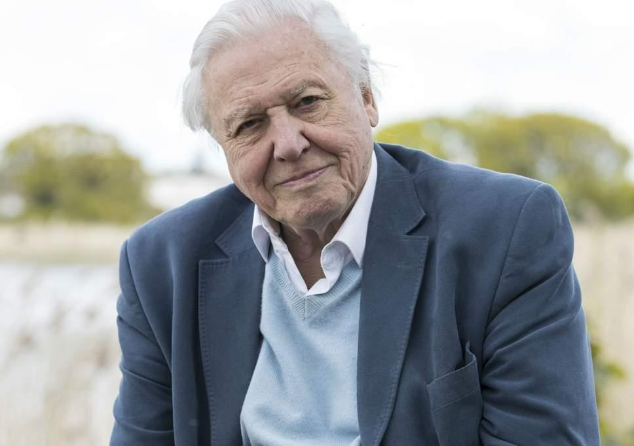
Q5
Who is this internationally famous scientist?

Slide 8
Q6
What is the outer most colour in a rainbow?

Slide 9
Q7
Lucy has $10. She spends $4.80 at the shops. How much does she have left?

Slide 10
Q8
Which company, starting with 'B', makes jet aircraft such as 747 and 737?

Slide 11
Q9
What, starting with 's', is the correct name for your backbone?

Slide 12
Q10
Peanuts grow underground. True of false?

Slide 13
ANSWERS
ROUND 1 Primary Section Years 5-6

Slide 14
Q1: ON WHICH POPULAR WEBSITE DO USERS SEND TWEETS?
ANSWER: TWITTER

Slide 15
Q2: WHAT INDUSTRY ARE HENRY FORD AND KARL BENZ ASSOCIATED WITH?
ANSWER: CARS

Slide 16
Q3: GREEN, LEATHERBACK AND LOGGERHEAD ARE TYPES OF: (A) DOG (B) CROCODILE (C) TURTLE?
ANSWER: (C) TURTLE

Slide 17
Q4: TRICEPS AND BICEPS ARE TYPES OF WHAT?
ANSWER: MUSCLE

Slide 18
Q5: WHO IS THIS INTERNATIONALLY FAMOUS SCIENTIST?
ANSWER: SIR DAVID ATTENBOROUGH

Slide 19
Q6: WHAT IS THE OUTER MOST COLOUR IN A RAINBOW?
ANSWER: RED

Slide 20
Q7: LUCY HAS $10. SHE SPENDS $4.80 AT THE SHOPS. HOW MUCH DOES SHE HAVE LEFT?
ANSWER: $5.20

Slide 21
Q8: WHICH COMPANY, STARTING WITH 'B', MAKES JET AIRCRAFT SUCH AS 747 AND 737?
ANSWER: BOEING

Slide 22
Q9: WHAT, STARTING WITH 'S', IS THE CORRECT NAME FOR YOUR BACKBONE?
ANSWER: SPINE

Slide 23
Q10: PEANUTS GROW UNDERGROUND. TRUE OF FALSE?
ANSWER: TRUE

Slide 24
QUESTIONS
ROUND 2 Primary Section Years 5-6

Slide 25
Q11
Sweat helps us to: (a) warm up (b) cool down?

Slide 26
Q12
Alice has 63 test-tubes. She has 3 times as many as Taika. How many test-tubes does Taika have?

Slide 27
Q13
What was the name of the first manned spacecraft to land on the moon?

Slide 28
Q14
How many items make up a "trio"?

Slide 29
Q15
A wombat is a marsupial native to which country?

Slide 30
Q16
A molar is a type of what?

Slide 31
Q17
How many legs does an adult insect have?

Slide 32
Q18
In a car what does the odometer measure?

Slide 33
Q19
What direction does a compass always point to?

Slide 34
Q20
What substance do most octopuses squirt when they are attacked?

Slide 35
ANSWERS
ROUND 2 Primary Section Years 5-6

Slide 36
Q11: SWEAT HELPS US TO: (A) WARM UP (B) COOL DOWN?
ANSWER: (B) COOL DOWN

Slide 37
Q12: ALICE HAS 63 TEST-TUBES. SHE HAS 3 TIMES AS MANY AS TAIKA. HOW MANY TEST-TUBES DOES TAIKA HAVE?
ANSWER: 21

Slide 38
Q13: WHAT WAS THE NAME OF THE FIRST MANNED SPACECRAFT TO LAND ON THE MOON?
ANSWER: APOLLO 11

Slide 39
Q14: HOW MANY ITEMS MAKE UP A "TRIO"?
ANSWER: 3

Slide 40
Q15: A WOMBAT IS A MARSUPIAL NATIVE TO WHICH COUNTRY?
ANSWER: AUSTRALIA

Slide 41
Q16: A MOLAR IS A TYPE OF WHAT?
ANSWER: TOOTH

Slide 42
Q17: HOW MANY LEGS DOES AN ADULT INSECT HAVE?
ANSWER: SIX

Slide 43
Q18: IN A CAR WHAT DOES THE ODOMETER MEASURE?
ANSWER: DISTANCE

Slide 44
Q19: WHAT DIRECTION DOES A COMPASS ALWAYS POINT TO?
ANSWER: NORTH

Slide 45
Q20: WHAT SUBSTANCE DO MOST OCTOPUSES SQUIRT WHEN THEY ARE ATTACKED?
ANSWER: INK

Slide 46
PRACTICAL TASK
This year we have 3 practical challenges:
Year of the Periodic Table Challenge
Building Challenge
Coding Challenge

Slide 47
Year of the Periodic Table Challenge (3 marks)
What element is found in and “closely associated with” the 6 everyday items you have been given. (2 of the items will have the same answer)

Slide 48
Building Challenge (4 marks)
Using only the equipment provided, build the tallest structure, as measured from the table surface to the top of the marshmallow. You have 15 minutes and should read the set of rules carefully
Over 5cm = 1 mark Over 20cm = 2 marks
Over 35cm = 2 marks Over 50cm = 4 marks

Slide 49
Coding Challenge (3 marks)
A Racetrack will be shown on screen and you must programme your team Bot to complete the circuit, from behind the Start line to over the Finish line. Instructions have been provided to each team
Reach Tyre Arch = 1 mark
Reach Man with Flag = 2 marks
Cross the finish line = 3 Marks

Slide 50
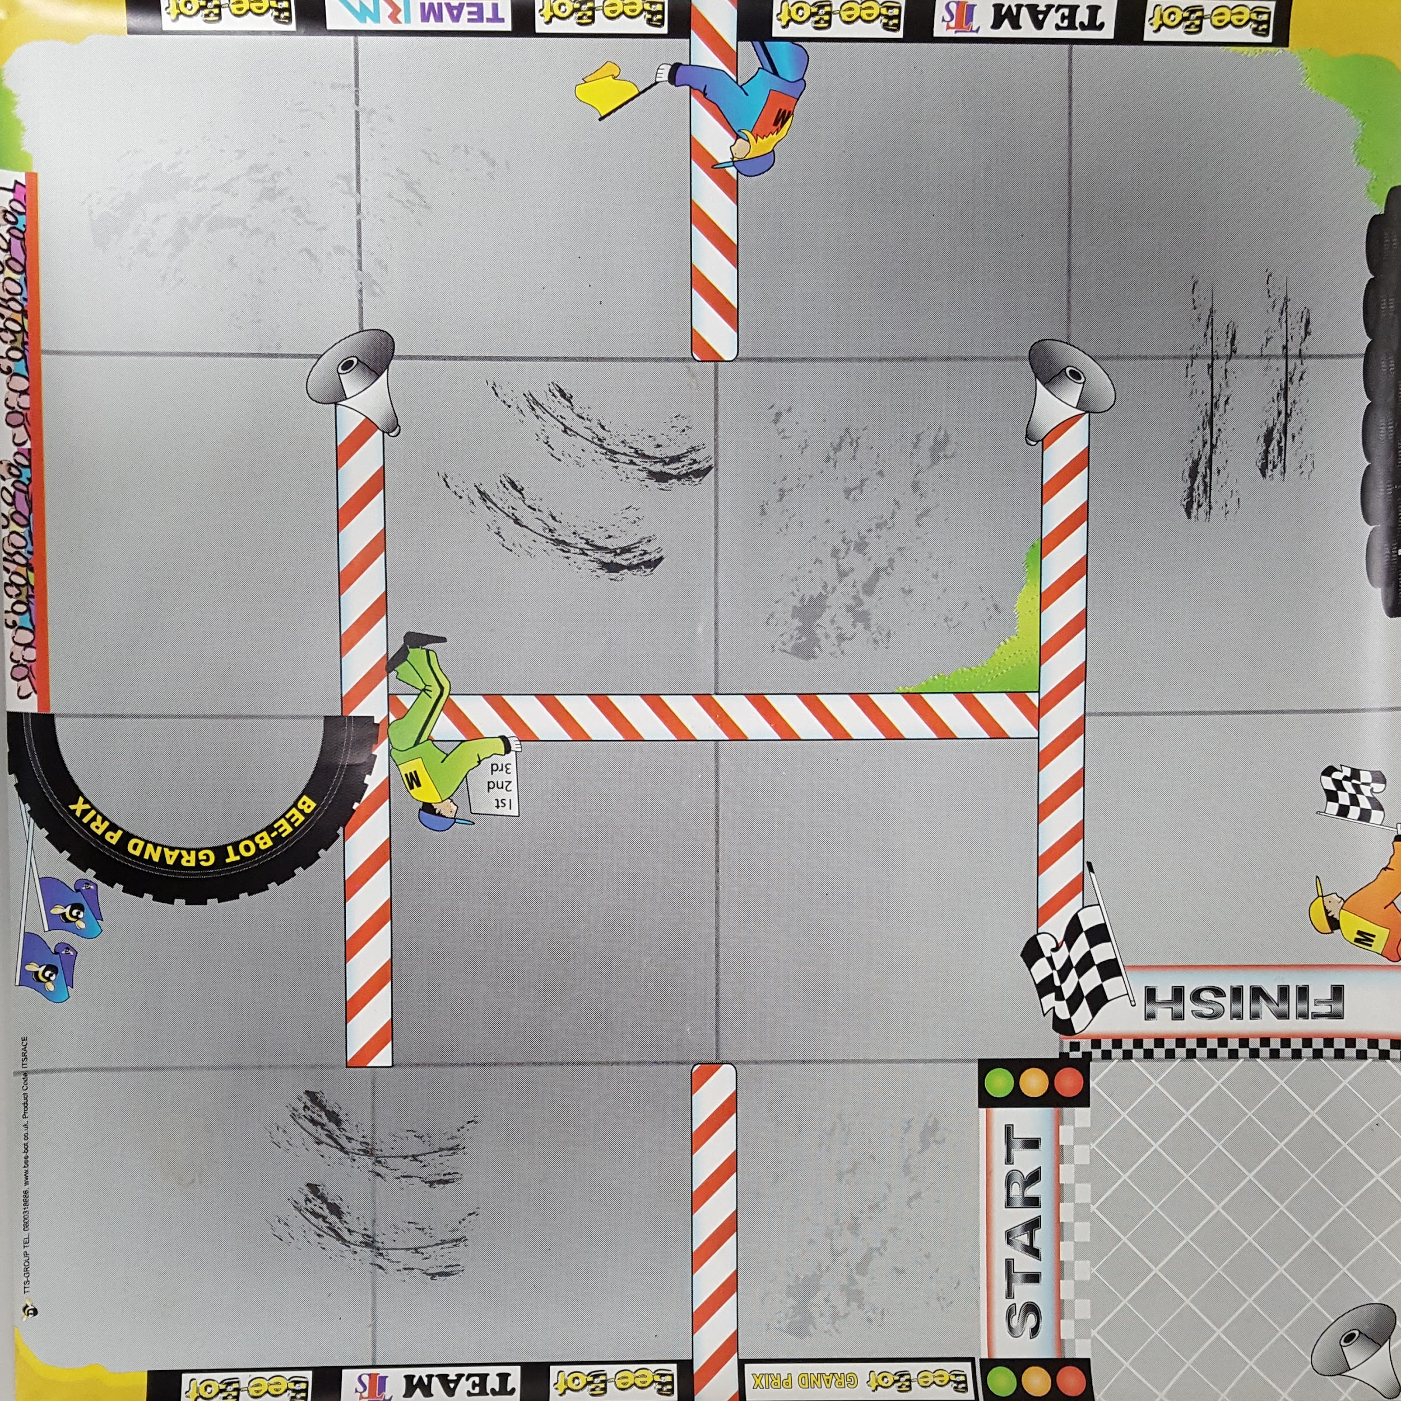

Slide 51
ELEMENT
CHALLENGE
ANSWERS

Slide 52
Year of the Periodic Table Challenge
A: Helium D: Tin
B: Aluminium E: Calcium
C: Fluorine F: Aluminium

Slide 53
QUESTIONS
ROUND 4 Primary Section Years 5-6

Slide 54
Q21
How many kidneys does a person usually have?

Slide 55
Q22
Round 133 to the nearest 100.?

Slide 56
Q23
In which country is NASA located?

Slide 57
Q24
Which planet is known as the 'red planet'?

Slide 58
Q25
What, starting with 't', is the name for the young of a frog?

Slide 59
Q26
How many zeros in ten million?

Slide 60
Q27
The human brain looks most like: (a) a light bulb (b) a large wrinkly walnut (c) a loaf of bread?

Slide 61
Q28
In mid-2019 the NZ Government will introduce a compulsory ban on the use of what widely used material?

Slide 62
Q29
52 divided by 4 equals what?

Slide 63
Q30
From which part of a cave do stalactites grow?

Slide 64
ANSWERS
ROUND 4 Primary Section Years 5-6

Slide 65
Q21: HOW MANY KIDNEYS DOES A PERSON USUALLY HAVE?
ANSWER: TWO

Slide 66
Q22: ROUND 133 TO THE NEAREST 100.?
ANSWER: 100

Slide 67
Q23: IN WHICH COUNTRY IS NASA LOCATED?
ANSWER: USA (AMERICA)

Slide 68
Q24: WHICH PLANET IS KNOWN AS THE 'RED PLANET'?
ANSWER: MARS

Slide 69
Q25: WHAT, STARTING WITH 'T', IS THE NAME FOR THE YOUNG OF A FROG?
ANSWER: TADPOLE

Slide 70
Q26: HOW MANY ZEROS IN TEN MILLION?
ANSWER: 7

Slide 71
Q27: THE HUMAN BRAIN LOOKS MOST LIKE: (A) A LIGHT BULB (B) A LARGE WRINKLY WALNUT (C) A LOAF OF BREAD?
ANSWER: (B) A LARGE WRINKLY WALNUT

Slide 72
Q28: IN MID-2019 THE NZ GOVERNMENT WILL INTRODUCE A COMPULSORY BAN ON THE USE OF WHAT WIDELY USED MATERIAL?
ANSWER: PLASTIC BAGS (SINGLE USE)

Slide 73
Q29: 52 DIVIDED BY 4 EQUALS WHAT?
ANSWER: 13

Slide 74
Q30: FROM WHICH PART OF A CAVE DO STALACTITES GROW?
ANSWER: CEILING (ROOF, TOP)

Slide 75
QUESTIONS
ROUND 5 Primary Section Years 5-6

Slide 76
Q31
Are tornadoes or hurricanes called 'twisters'?

Slide 77
Q32
What computer software company did Bill Gates found?

Slide 78
Q33
What is a group of bees on the move called?

Slide 79
Q34
The Māori word 'pūtaiao' refers to what? A: Science B: Technology C: Engineering D: Maths?

Slide 80
Q35
The World Wide _____ was invented in 1989?

Slide 81
Q36
What, starting with 'p', is a gem made by oysters?

Slide 82
Q37
The retina is found in which part of your body?

Slide 83
Q38
What number does the Roman numeral 'X' stand for?

Slide 84
Q39
If it takes 9 minutes to run one kilometre, how long would it take to run 18 kilometres?

Slide 85
Q40
What material is a spider's web made from?

Slide 86
ANSWERS
ROUND 5 Primary Section Years 5-6

Slide 87
Q31: ARE TORNADOES OR HURRICANES CALLED 'TWISTERS'?
ANSWER: TORNADOES

Slide 88
Q32: WHAT COMPUTER SOFTWARE COMPANY DID BILL GATES FOUND?
ANSWER: MICROSOFT

Slide 89
Q33: WHAT IS A GROUP OF BEES ON THE MOVE CALLED?
ANSWER: SWARM

Slide 90
Q34: THE MĀORI WORD'PŪTAIAO' REFERS TO WHAT?
ANSWER: A: SCIENCE

Slide 91
Q35: THE WORLD WIDE _____ WAS INVENTED IN 1989?
ANSWER: WEB

Slide 92
Q36: WHAT, STARTING WITH 'P', IS A GEM MADE BY OYSTERS?
ANSWER: PEARL

Slide 93
Q37: THE RETINA IS FOUND IN WHICH PART OF YOUR BODY?
ANSWER: EYE

Slide 94
Q38: WHAT NUMBER DOES THE ROMAN NUMERAL 'X' STAND FOR?
ANSWER: 10

Slide 95
Q39: IF IT TAKES 9 MINUTES TO RUN ONE KILOMETRE, HOW LONG WOULD IT TAKE TO RUN 18 KILOMETRES?
ANSWER: 162 MINUTES

Slide 96
Q40: WHAT MATERIAL IS A SPIDER'S WEB MADE FROM?
ANSWER: SILK

Slide 97
Well done to all teams participating in STEMM Student Challenge 2019
huttscience.co.nz

Slide 98
TIE BREAKER

Slide 99
Question
Reptiles are cold-blooded. True or false?

Slide 100
Answer
True

Slide 101
Question
What colour do we normally think of a sapphire as being?

Slide 102
Answer
Blue

Slide 103
Question
What element is used in swimming pools?

Slide 104
Answer
Chlorine

Slide 105
Question
What is the epidermis the outer layer of?

Slide 106
Answer
Skin

Slide 107
Question
True or false? -2 is an integer.?

Slide 108
Answer
True

Slide 109
Question
What, starting with "s", is a combination of smoke and fog?

Slide 110
Answer
Smog

Slide 111
Question
The femur is a bone found in the arm. True or false?

Slide 112
Answer
False. The upper leg bone

Slide 113
Question
What sense is missing from this list? Touch, smell, sight, hearing, _____ ?

Slide 114
Answer
Taste

Slide 115
Question
Write one thousand and sixty-three as a digit?

Slide 116
Answer
1063

Slide 117
Question
65 - 43 = ?

Slide 118
Answer
22

