Slide 1
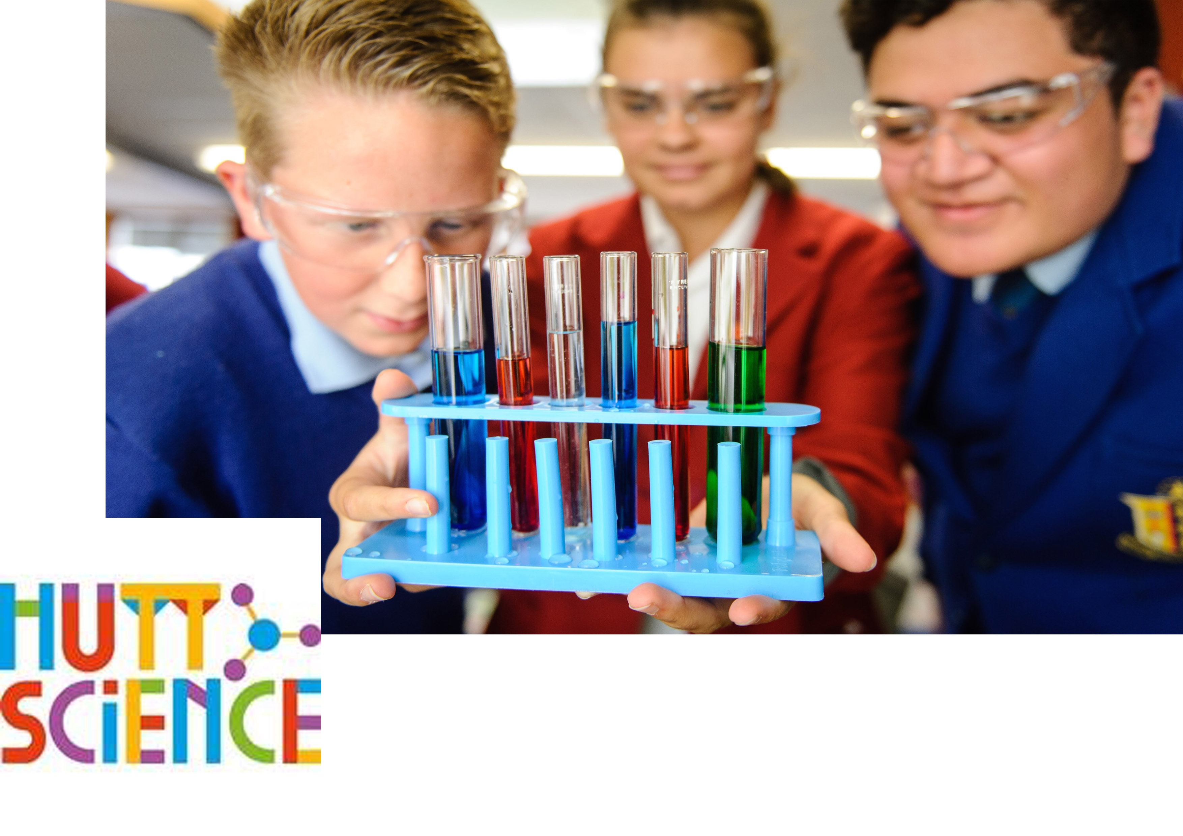
STEMM Student Challenge 2018

Slide 2
QUESTIONS
ROUND 1
Senior Section
Years 11-13

Slide 3
Q1
What German physicist was the first to broadcast and receive radio waves?

Slide 4
Q2
Which one of Snow White's seven dwarfs most likely suffers from aphasia?

Slide 5
Q3
What kind of poisoning is known as plumbism?

Slide 6
Q4
IMAGE Name this NZ microbiologist and bioluminescence enthusiast?

Slide 7
Q5
How many letters of the alphabet are also Roman numerals?

Slide 8
Q6
Bronze is made from what two metals?

Slide 9
Q7
The first letter from each of what five words constitute PLUTO when referring to the oil industry?

Slide 10
Q8
What element makes up 89% of water's weight?

Slide 11
Q9
What season does a hiemal activity normally take place in?

Slide 12
Q10
What was helium first discovered in - and named after?

Slide 13
ANSWERS
ROUND 1
Senior Section
Years 11-13

Slide 14
Q1:
What German physicist was the first to broadcast and receive radio waves?
Answer: Heinrich Hertz

Slide 15
Q2:
Which one of Snow White's seven dwarfs most likely suffers from aphasia?
Answer: Dopey

Slide 16
Q3:
What kind of poisoning is known as plumbism?
Answer: Lead poisoning

Slide 17
Q4:
IMAGE Name this NZ microbiologist and bioluminescence enthusiast?
Answer: Dr Siouxsie Wiles

Slide 18
Q5:
How many letters of the alphabet are also Roman numerals?
Answer: Seven (I, V, X, L, C, D, M)

Slide 19
Q6:
Bronze is made from what two metals?
Answer: Copper and tin

Slide 20
Q7:
The first letter from each of what five words constitute PLUTO when referring to the oil industry?
Answer: Pipes Laid Under The Ocean

Slide 21
Q8:
What element makes up 89% of water's weight?
Answer: Oxygen

Slide 22
Q9:
What season does a hiemal activity normally take place in?
Answer: Winter

Slide 23
Q10:
What was helium first discovered in - and named after?
Answer: The Sun (Greek Helios)

Slide 24
QUESTIONS
ROUND 2
Senior Section
Years 11-13

Slide 25
Q11
Facebook has come under fire for selling data to a company, accused of influencing the American election. What is the name of that company?

Slide 26
Q12
Which acute viral infection of the central nervous system is also known as 'hydrophobia'?

Slide 27
Q13
In radio communication, what is the common one word abbreviation of the phrase "Will Comply"?

Slide 28
Q14
Which type of native NZ insect is the Kekerengu?

Slide 29
Q15
Also called white pine, which is NZ's tallest forest tree, with recorded heights of 60m?

Slide 30
Q16
NZ's 'Rocket Lab' launched it's first rocket into orbit, from where in NZ?

Slide 31
Q17
What nationality was 16th century astronomer Nicolas Copernicus?

Slide 32
Q18
What's the final stage in the lifecycle of an organism?

Slide 33
Q19
Which chemical compound is also known as caustic soda or lye?

Slide 34
Q20
What is the common name for the native NZ shellfish also known as Haliotis Iris?

Slide 35
ANSWERS
ROUND 2
Senior Section
Years 11-13

Slide 36
Q11:
Facebook has come under fire for selling data to a company, accused of influencing the American election. What is the name of that company?
Answer: Cambridge Analytica

Slide 37
Q12:
Which acute viral infection of the central nervous system is also known as 'hydrophobia'?
Answer: Rabies

Slide 38
Q13:
In radio communication, what is the common one word abbreviation of the phrase "Will Comply"?
Answer: Wilco

Slide 39
Q14:
Which type of native NZ insect is the Kekerengu?
Answer: Cockroach

Slide 40
Q15:
Also called white pine, which is NZ's tallest forest tree, with recorded heights of 60m?
Answer: Kahikatea

Slide 41
Q16:
NZ's 'Rocket Lab' launched it's first rocket into orbit, from where in NZ?
Answer: Mahia Peninsula

Slide 42
Q17:
What nationality was 16th century astronomer Nicolas Copernicus?
Answer: Polish

Slide 43
Q18:
What's the final stage in the lifecycle of an organism?
Answer: Death

Slide 44
Q19:
Which chemical compound is also known as caustic soda or lye?
Answer: Sodium Hydroxide

Slide 45
Q20:
What is the common name for the native NZ shellfish also known as Haliotis Iris?
Answer: Paua

Slide 46
PRACTICAL TASK

Slide 49
QUESTIONS
ROUND 4
Senior Section
Years 11-13

Slide 50
Q21
What British TV show is computer programing language 'Python' named after?

Slide 51
Q22
Horology is the science of measuring what?

Slide 52
Q23
The internet term HTML is an abbreviation of what?

Slide 53
Q24
Which two metals principally form the natural alloy electrum?

Slide 54
Q25
What angle exists, between the hands of an analog clock (that's the one where the hands go around) if the time is 12:20?

Slide 55
Q26
Which constellation is also know as Crux?

Slide 56
Q27
Formaldehyde is a compound of oxygen, hydrogen, and which other element?

Slide 57
Q28
Atoms of the same chemical element that have different atomic mass are known as?

Slide 58
Q29
In astronomy, what is the common term for the outermost region of the suns atmosphere?

Slide 59
Q30
Which metal is commonly used to galvanise iron?

Slide 60
ANSWERS
ROUND 4
Senior Section
Years 11-13

Slide 61
Q21:
What British TV show is computer programing language 'Python' named after?
Answer: Monty Python's Flying Circus

Slide 62
Q22:
Horology is the science of measuring what?
Answer: Time

Slide 63
Q23:
The internet term HTML is an abbreviation of what?
Answer: Hyper Text Markup Language

Slide 64
Q24:
Which two metals principally form the natural alloy electrum?
Answer: Silver and Gold

Slide 65
Q25:
What angle exists, between the hands of an analog clock (that's the one where the hands go around) if the time is 12:20?
Answer: 110 degrees or 250 degrees

Slide 66
Q26:
Which constellation is also know as Crux?
Answer: The Southern Cross

Slide 67
Q27:
Formaldehyde is a compound of oxygen, hydrogen, and which other element?
Answer: Carbon

Slide 68
Q28:
Atoms of the same chemical element that have different atomic mass are known as?
Answer: Isotopes

Slide 69
Q29:
In astronomy, what is the common term for the outermost region of the suns atmosphere?
Answer: Corona

Slide 70
Q30:
Which metal is commonly used to galvanise iron?
Answer: Zinc

Slide 71
QUESTIONS
ROUND 5
Senior Section
Years 11-13

Slide 72
Q31
What is common name of the serious fungal disease that affects Pohutakawa, Manuka and Rata?

Slide 73
Q32
The duodecimal system is based on which number?

Slide 74
Q33
In humans, insulin is a hormone secreted by cells in which glandular organ?

Slide 75
Q34
In geology the three divisions of the mesozoic era are: Triassic, Jurassic and which other?

Slide 76
Q35
'Measurement of the circle' is a work by which 3rd century BC Greek Mathematician?

Slide 77
Q36
What is the common name for BSE or Bovine Spongiform Encephalopathy?

Slide 78
Q37
How many numbers between 101 and 200 have an odd number of factors?

Slide 79
Q38
What does REM stand for when applied to sleep?

Slide 80
Q39
Image Who is entomologist Ruud Kleinpaste better know as?

Slide 81
Q40
In NZ in the 1950's, which South Canterbury farmer developed the Jet Boat?

Slide 82
ANSWERS
ROUND 5
Senior Section
Years 11-13

Slide 83
Q31:
What is common name of the serious fungal disease that affects Pohutakawa, Manuka and Rata?
Answer: Myrtle Rust

Slide 84
Q32:
The duodecimal system is based on which number?
Answer: 12

Slide 85
Q33:
In humans, insulin is a hormone secreted by cells in which glandular organ?
Answer: Pancreas

Slide 86
Q34:
In geology the three divisions of the mesozoic era are: Triassic, Jurassic and which other?
Answer: Cretaceous

Slide 87
Q35:
'Measurement of the circle' is a work by which 3rd century BC Greek Mathematician?
Answer: Archimedes

Slide 88
Q36:
What is the common name for BSE or Bovine Spongiform Encephalopathy?
Answer: Mad Cow Diesease

Slide 89
Q37:
How many numbers between 101 and 200 have an odd number of factors?
Answer: 3 numbers (121, 144, 169) (11, 12 and 13 squared)

Slide 90
Q38:
What does REM stand for when applied to sleep?
Answer: Rapid eye movement

Slide 91
Q39:
Image Who is entomologist Ruud Kleinpaste better know as?
Answer: Bug Man

Slide 92
Q40:
In NZ in the 1950's, which South Canterbury farmer developed the Jet Boat?
Answer: William Hamilton

Slide 93
Well done to all teams participating in STEMM Student Challenge 2017
huttscience.co.nz

Slide 94
TIE BREAKER

Slide 95
Question
Rickets is a diesease caused by a deficiency of which vitamin?

Slide 96
Answer
Vitamin D

Slide 97
Question
Which migratory bird is known in Maori as Kuaka?

Slide 98
Answer
Godwit

Slide 99
Question
True or false? Plasma is a state of matter?

Slide 100
Answer
True

Slide 101
Question
The name of which narcotic drug is named after Morpheus the Greek god of dreams?

Slide 102
Answer
Morphine

Slide 103
Question
DNA is an abbreviation for?

Slide 104
Answer
Deoxyribonucleic acid

Slide 105
Question
What is the common name for 'nacre', the irridescent internal layer of certain mollusk shells?

Slide 106
Answer
Mother-of-pearl

Slide 107
Question
Wine is classified into 3 major categories: Still, Sparkling and which other?

Slide 108
Answer
Fortified

Slide 109
Question
What body opening are the labial and buccal glands in?

Slide 110
Answer
The mouth

Slide 111
Question
Introduced in 1773, which breed of sheep was the first to arrive in NZ?

Slide 112
Answer
Merino

Slide 113
Question
What bacterial infection is currently resulting in the culling of large numbers of dairy cows in NZ?

Slide 114
Answer
Mycoplasma bovis

